Slide 1
Voice-controlled elevator
under supervision of Dr Omar mokhtar

Slide 2
Corona
COVID-19 is a rapidly growing pandemic with its first case identified during December 2019 in Wuhan, Hubei Province, China. Due to the rampant rise in the number of cases in China and globally, WHO declared COVID-19 as a pandemic on 11th March 2020.

Slide 3
Corona
Covid tends to infect all age groups and is transmitted via direct contact or respiratory droplets generated during coughing or sneezing by the infected patient during both symptomatic or pre-symptomatic phase of infection.

Slide 4
Corona
Other routes of transmission include fecal-oral route and fomites along with small risk of vertical transmission from mother to child if infection occurs during third trimester of pregnancy.

Slide 5
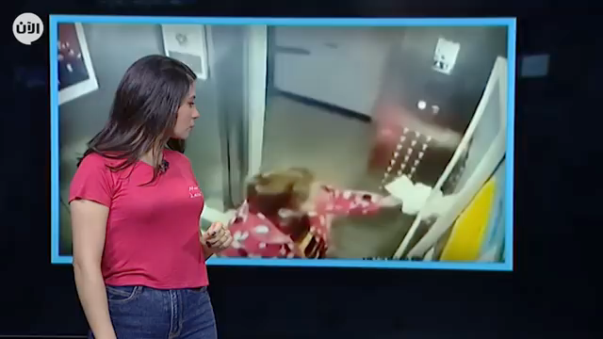
corona

Slide 6
Project Idea
one of the reasons for Corona spread was the use of elevators and what was happening inside elevators from patients trying to Spreading the disease to infect others, so it was necessary to have an alternative to using the elevator without pressing the control buttons.

Slide 7
Project Idea
So we thought of creating speech recognition device, that enables users to use a voice recognition elevator without touching any buttons.

Slide 8
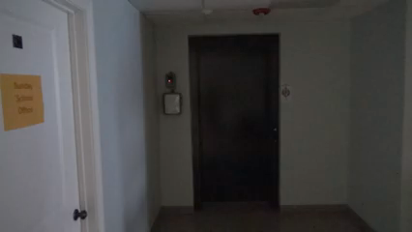
Project Idea

Slide 9
BENEFITS
Protection from Covid-19 and any other viruses.
Assistance to visually impaired people.
Easy and quick access of visitors to the building’s habitants (apartments, offices, etc).

Slide 10
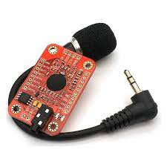
Voice Recognition Module V3

Slide 11
Overview
ELECHOUSE Voice Recognition Module is a compact and easy-control speaking recognition board.
This product is a speaker-dependent voice recognition module.
It supports up to 80 voice commands in all. Max 7 voice commands could work at the same time.
Any sound could be trained as command. Users need to train the module first before let it recognizing any voice command.
This board has controlling way: Serial Port

Slide 12
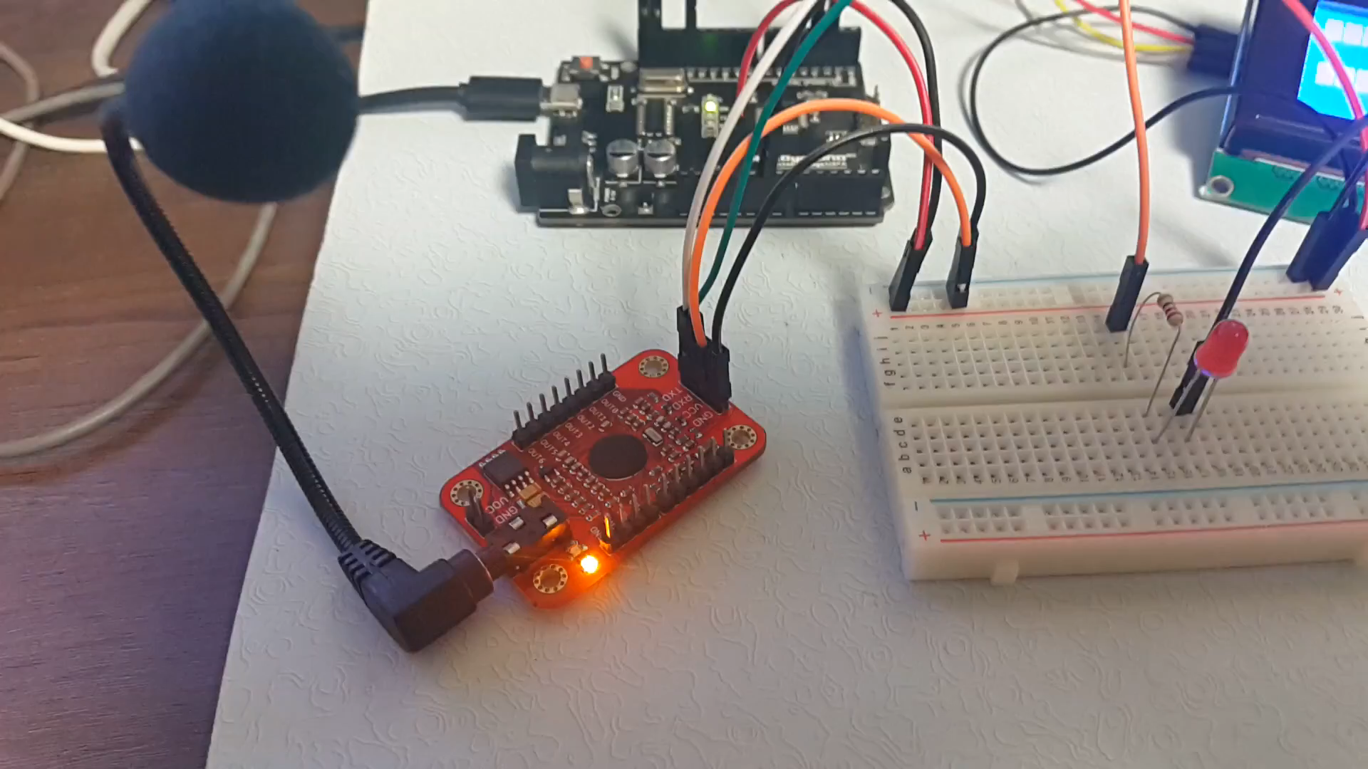
Video

Slide 13
UART

Slide 14
Problems
the price
non-proliferation
No solution to problems
Can't Matching Voice

Slide 15
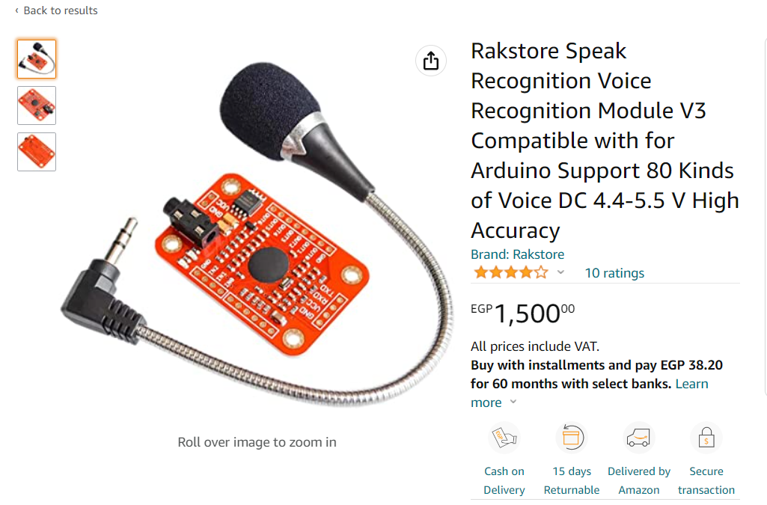
the price

Slide 16
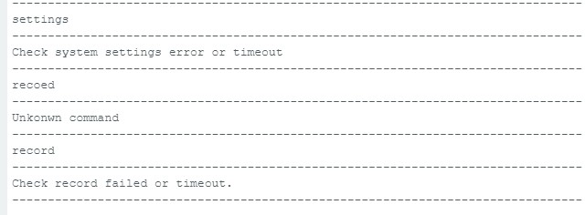
No solution to problems

Slide 17
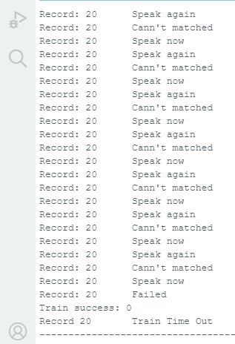
Can't Matching Voice

Slide 18
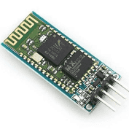
Bluetooth module hc-05

Slide 19
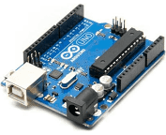
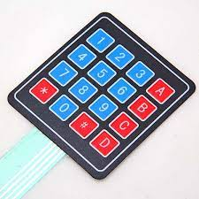
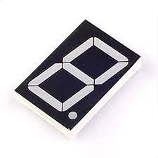
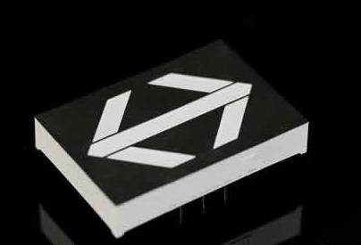
Hardware

Slide 20
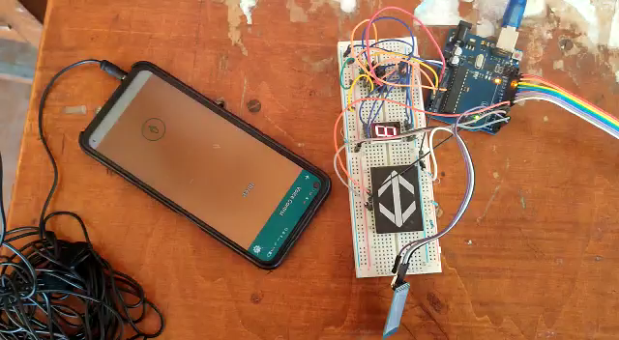
video

